Slide 1
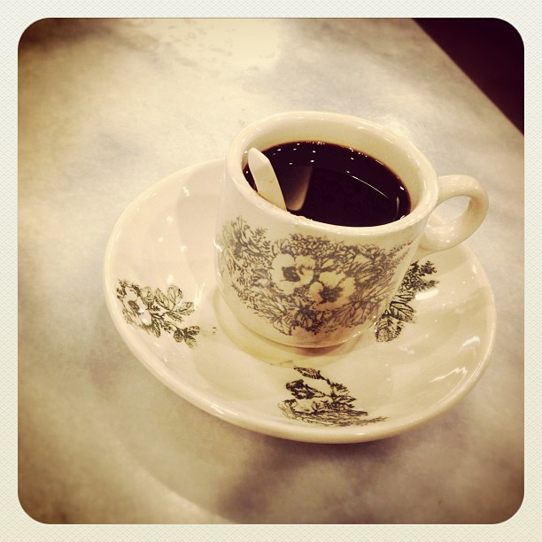
Lecture 2: What is/was your Ah-Gong saying?
Chinese dialects and Chinese dialect groups
Notes:
How many dialect s groups (at least 10)
Must use both the language and the regions simultaneously to understand the groups better
And to better understand their dynamics between them

Slide 2
CMIO model
Synchronically and historically, the Chinese race in Singapore is and was not homogeneous.

Slide 3
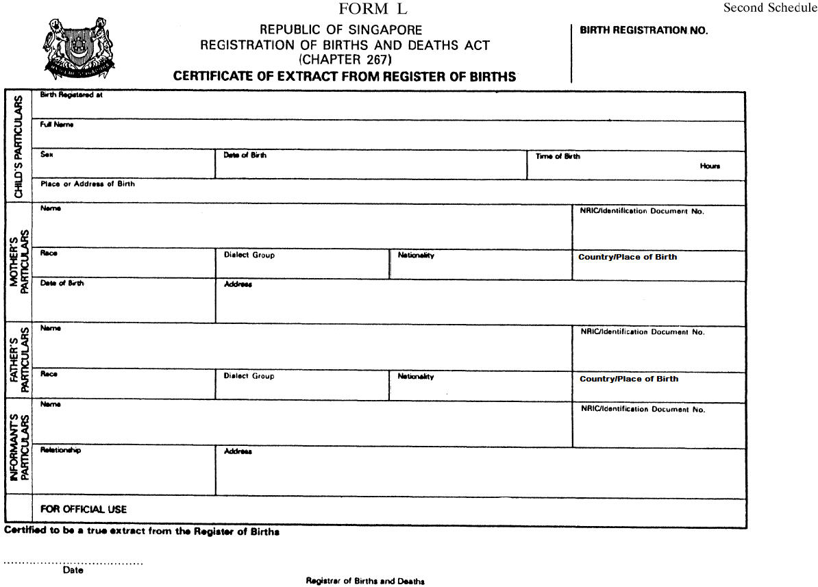

Slide 4

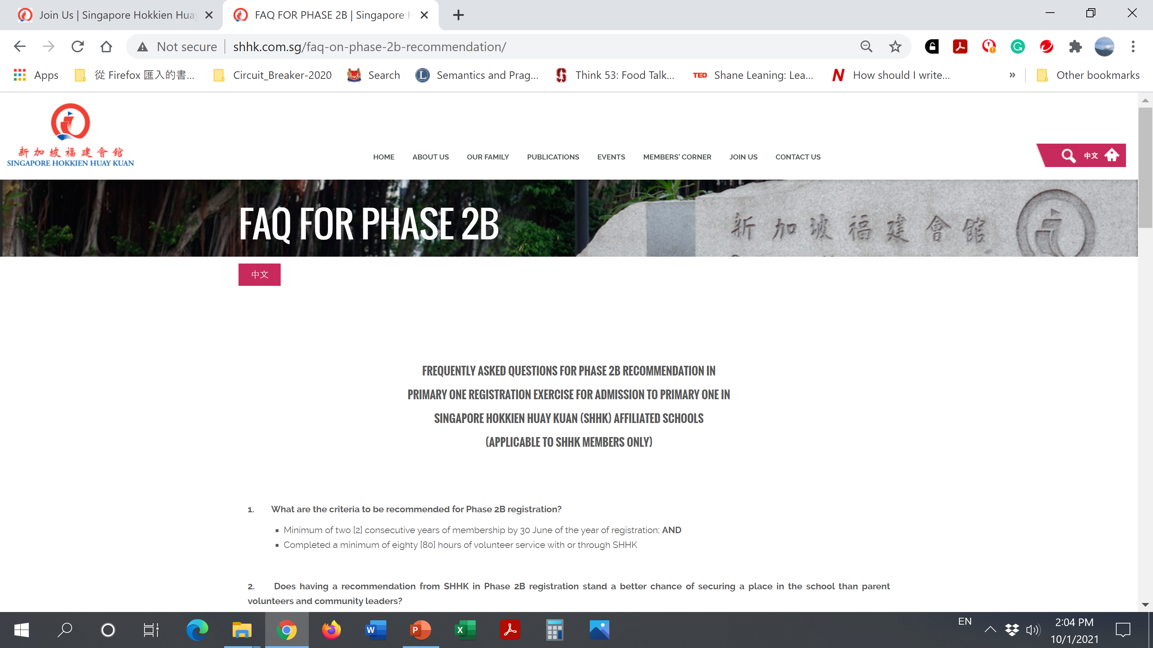

Slide 6
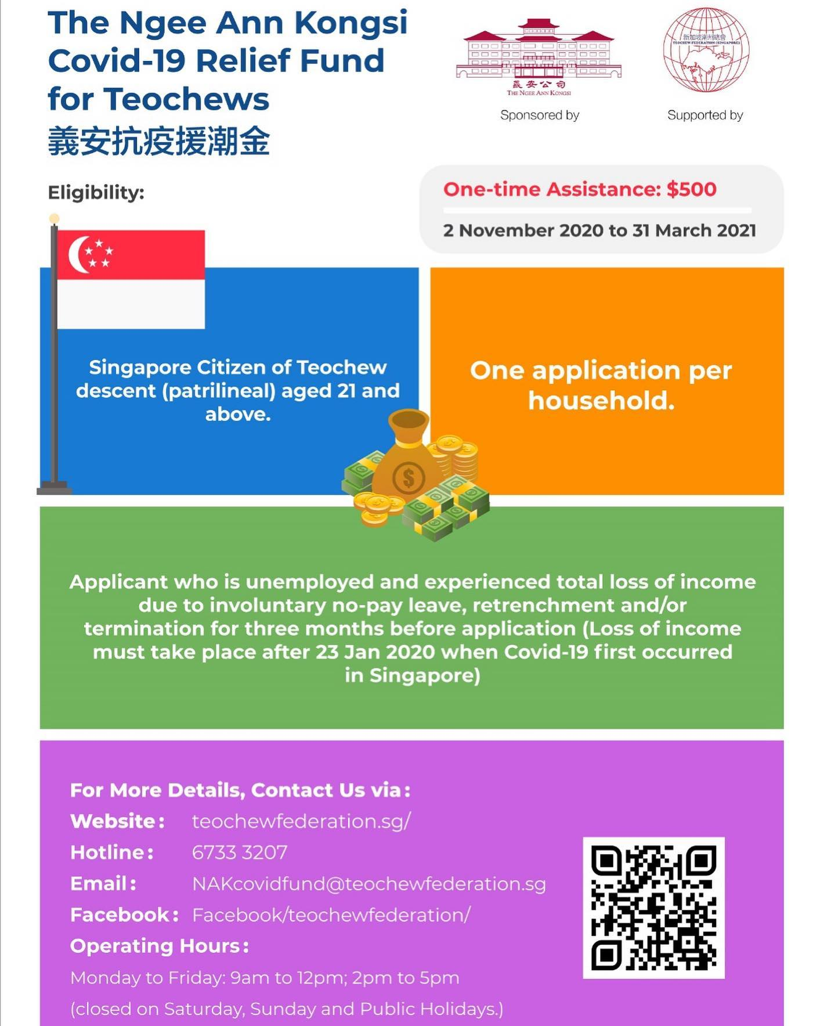

Slide 7

The context behind this question
Notes:
Context: Means that last time, there is a higher chance of only marrying within your own dialect group (grandparents)

Slide 8
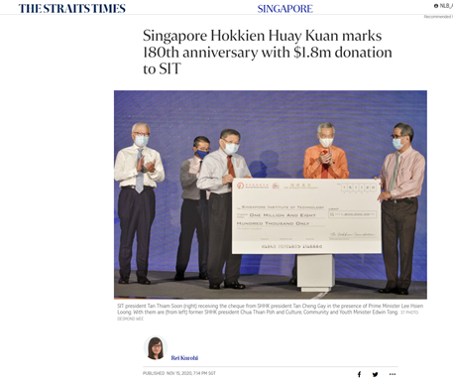
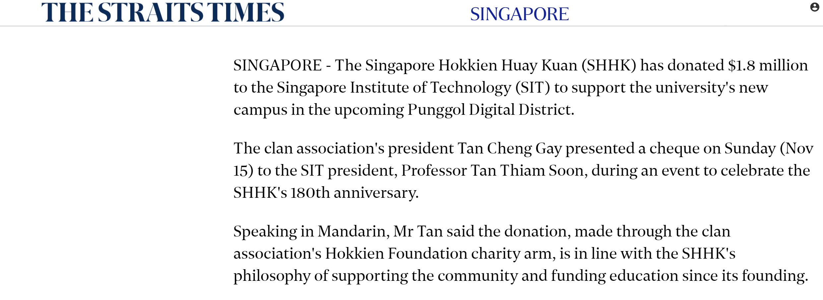
Notes:
Usually its own dialect will help their own people

Slide 9
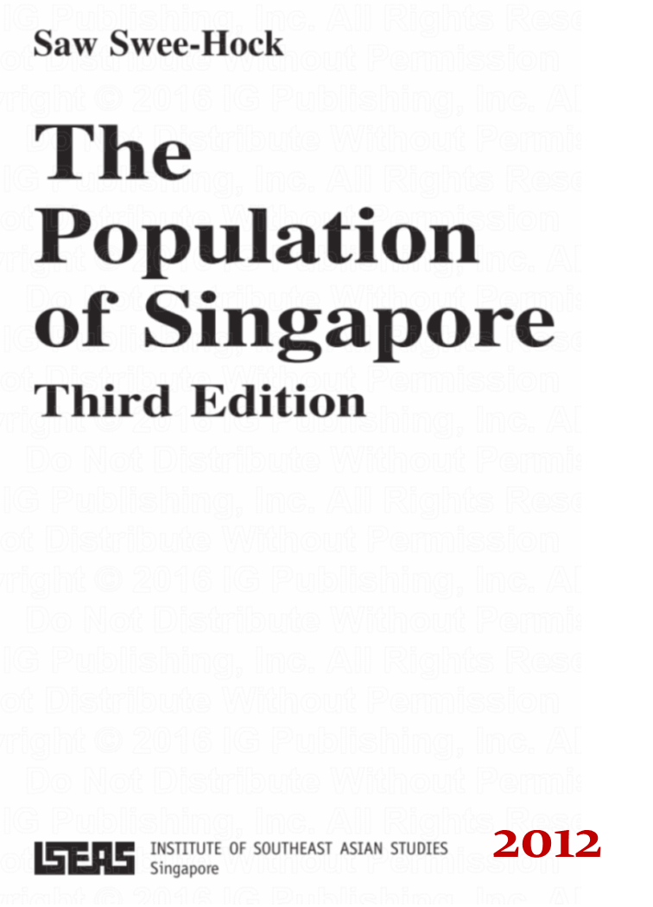
How many dialect groups are there in Singapore?

Slide 10
Chinese in Singapore
Are they equally distributed?

Slide 12
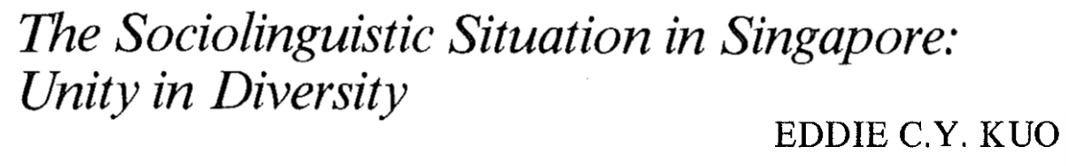

Slide 13

Notes:
3 observations

Slide 15
40%
23%
20%
7%
6%

Slide 16
Singapore as an immigrant society and Chinese dialects

Slide 17
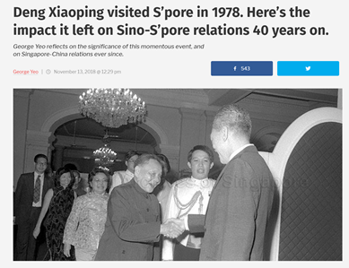
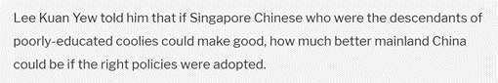

Slide 18
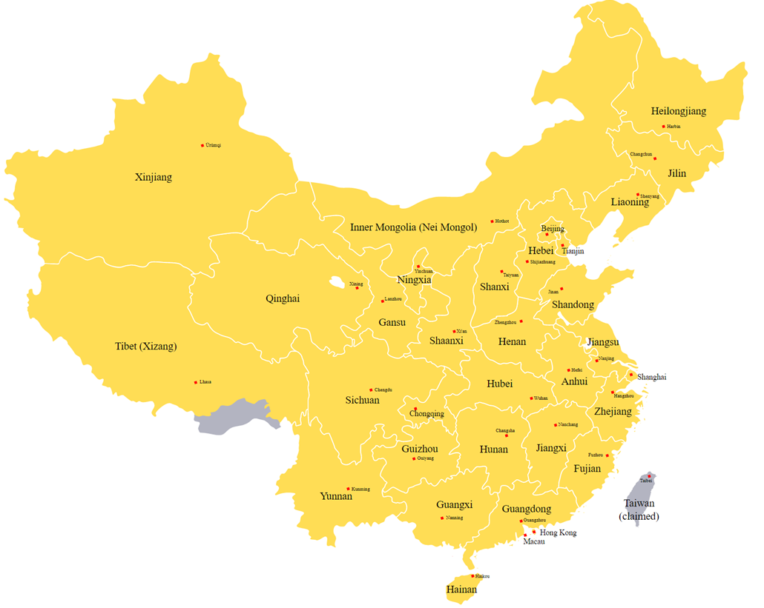
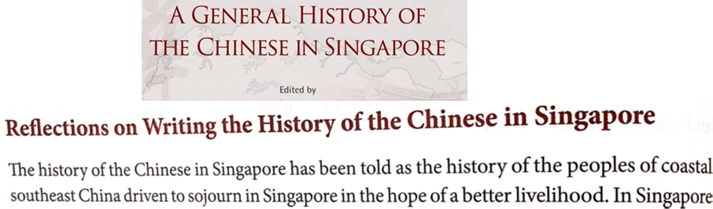
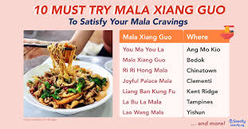

Slide 19
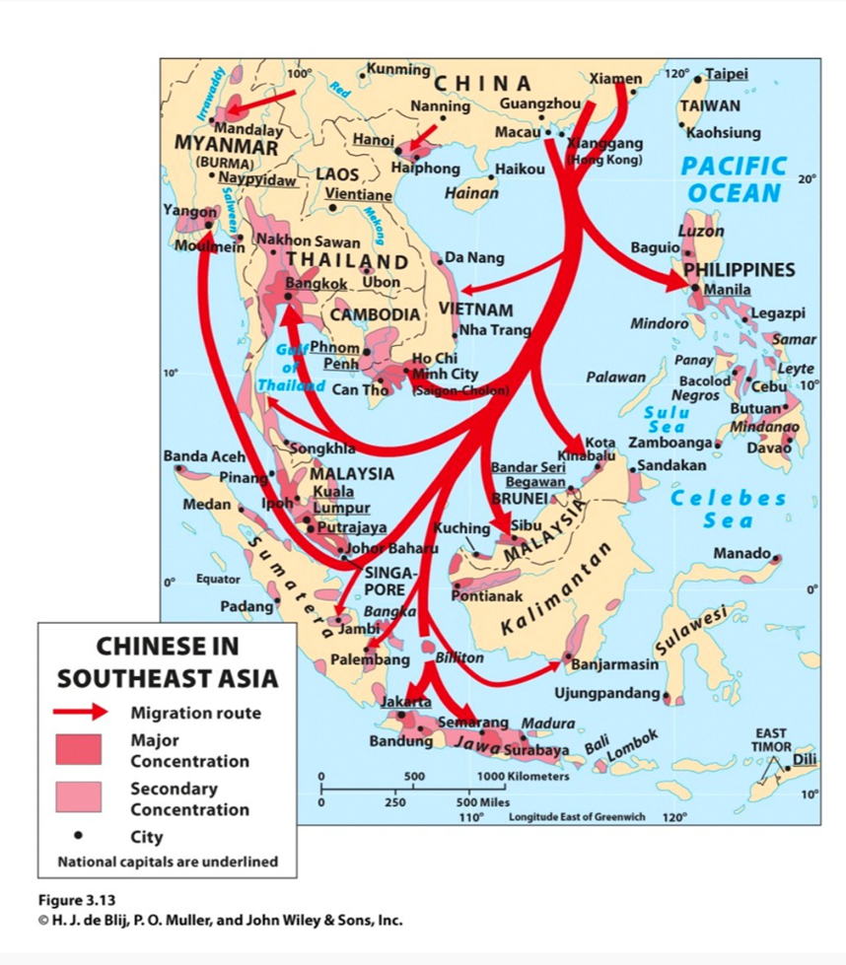

Slide 20
A brief linguistic introduction to modern Chinese dialects

Slide 21
Chinese Language
Notes:
Mean they are unable to understand each other

Slide 22
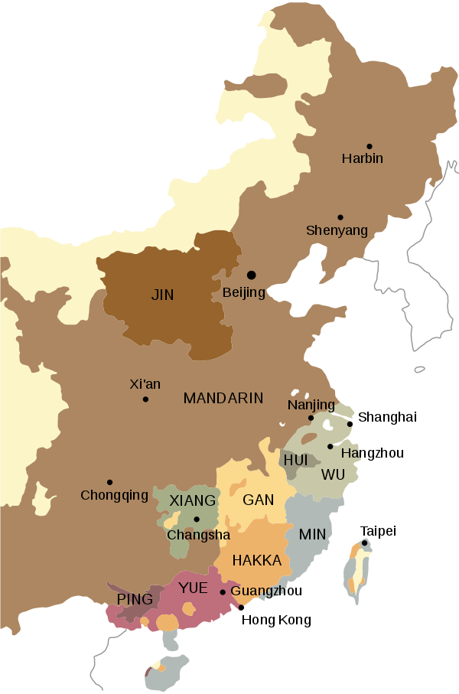
Geographical distribution of Modern Chinese dialects in China

Slide 23
The Min dialects

Slide 24
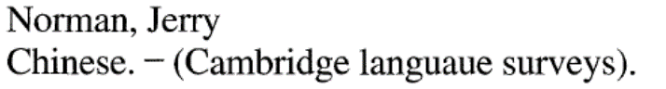
The Min dialects

Slide 25
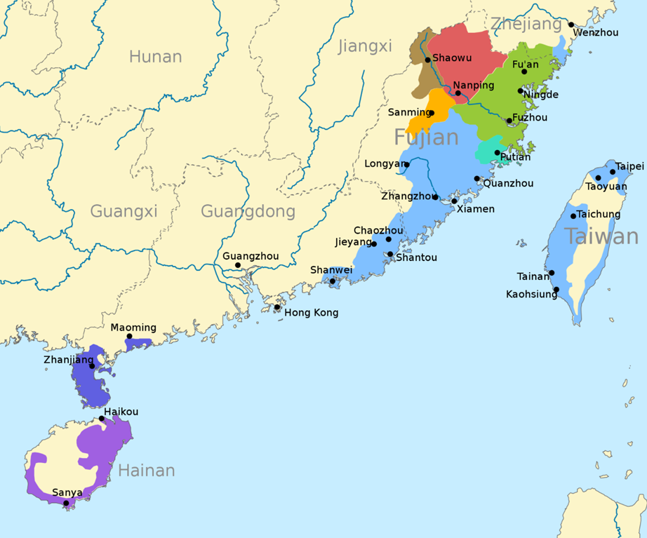
Sub-dialects of the Min dialects

Slide 26
Sub-dialects within the Min dialects

Slide 27
Sub-dialects of the Min dialects
Notes:
Only focus on the coastal regions
Light blue – heng hwa
Light green
blue

Slide 28
Southern Min dialects
Northeastern Min dialects

Slide 29
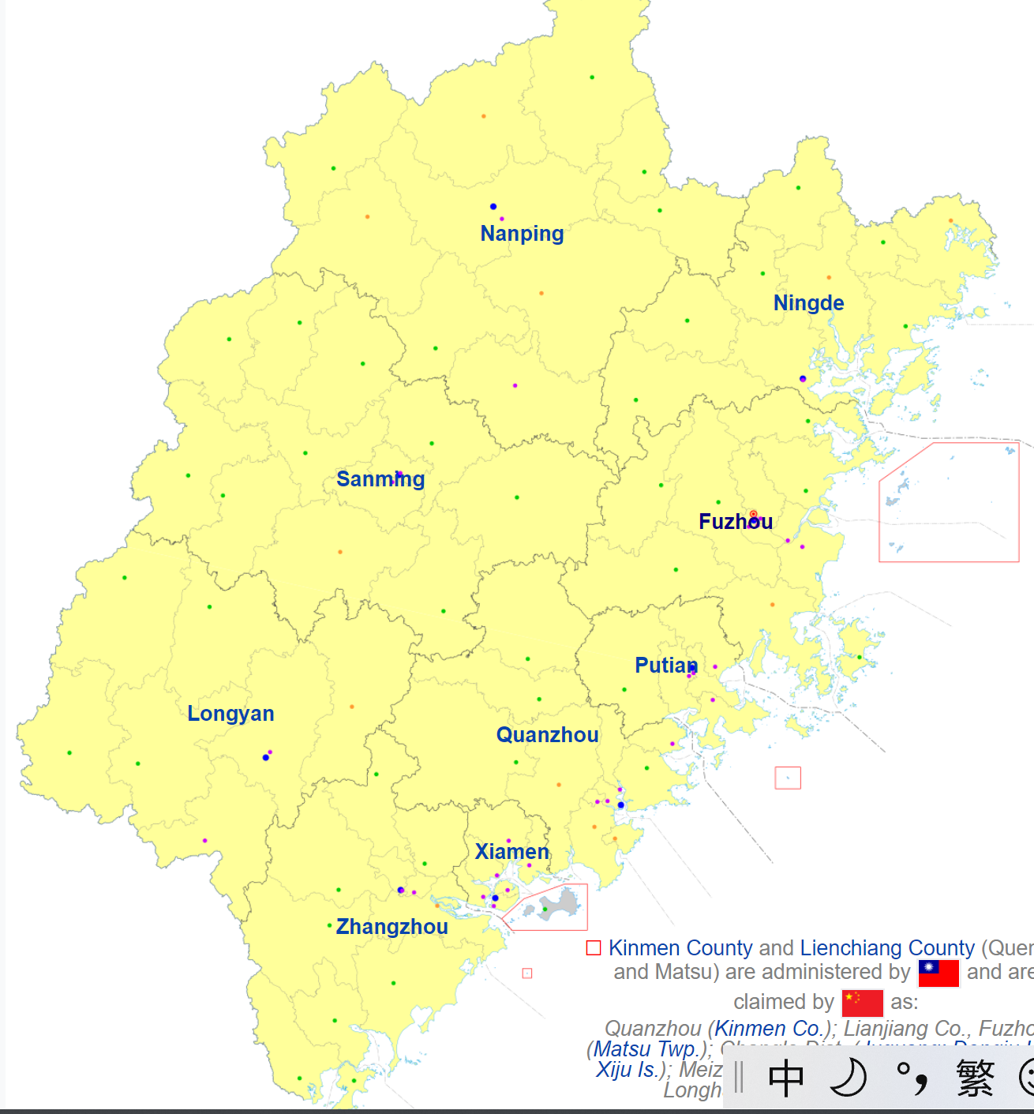
Map of Fujian province
Notes:
Focusing on the prefectures in the Fujian province

Slide 30
Hock Chew and Hockchia dialect groups in Singapore

Slide 33

Fuzhou (Foochow/Hock Chew) dialect lesson

Slide 34

The issue of Hockchia dialect group
Notes:
From the city fu qing (hock chia) within the fu zhou prefecture under the Fujian province

Slide 35
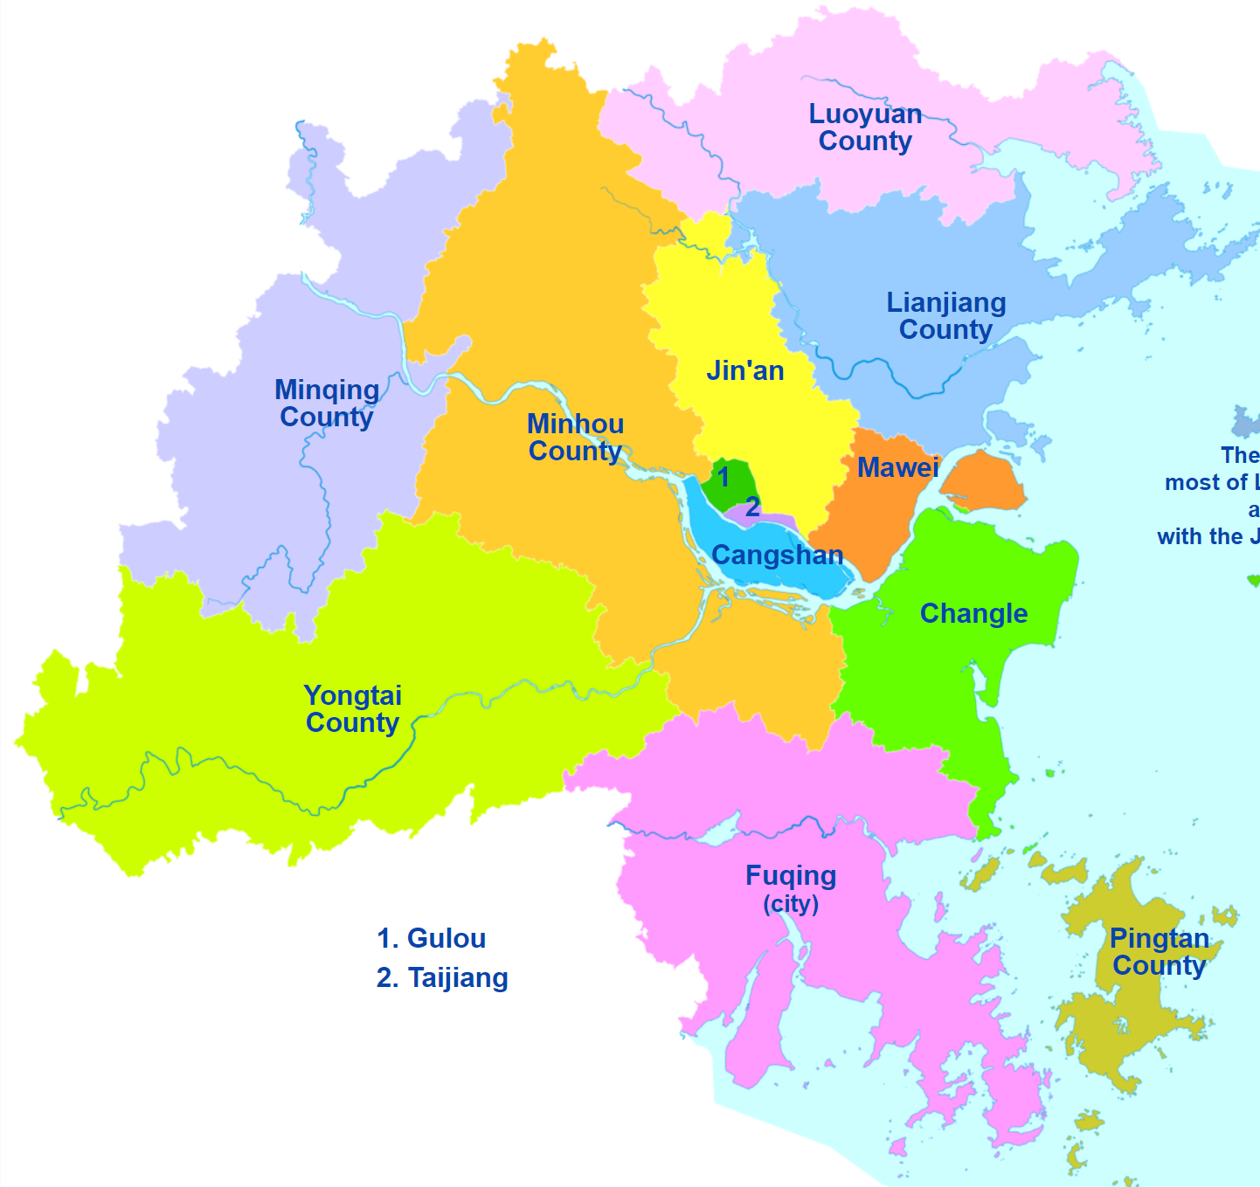
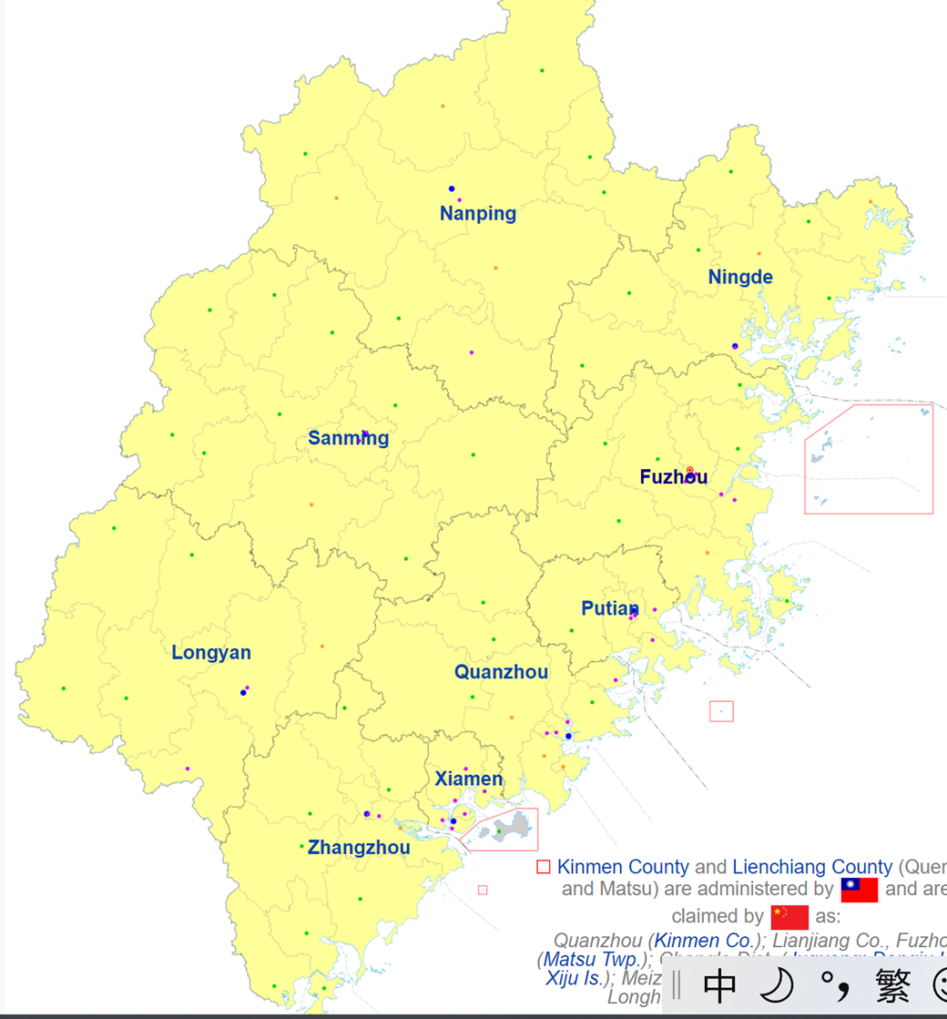
Map of the Fuzhou prefecture

Slide 36
Membership to Singapore Foochow Association
Notes:
Hock chia ppl are allowed within the hock chew association – showing their close relationship (geographical reasons?)

Slide 37
Southern Min dialects & the Hokkien and Teochew dialect groups

Slide 38
The issue of Hokkien dialect
Map of Fujian province
Notes:
Xiamen city, Zhangzhou and Quanzhou prefecture

Slide 39
The term “Hokkien dialect”/ “Hokkien people” used in Singapore is a misnomer
Notes:
“hokkien” only takes up the southern part of the Fujian province, so Fujian dialect is wrong since its not the whole Fujian

Slide 40
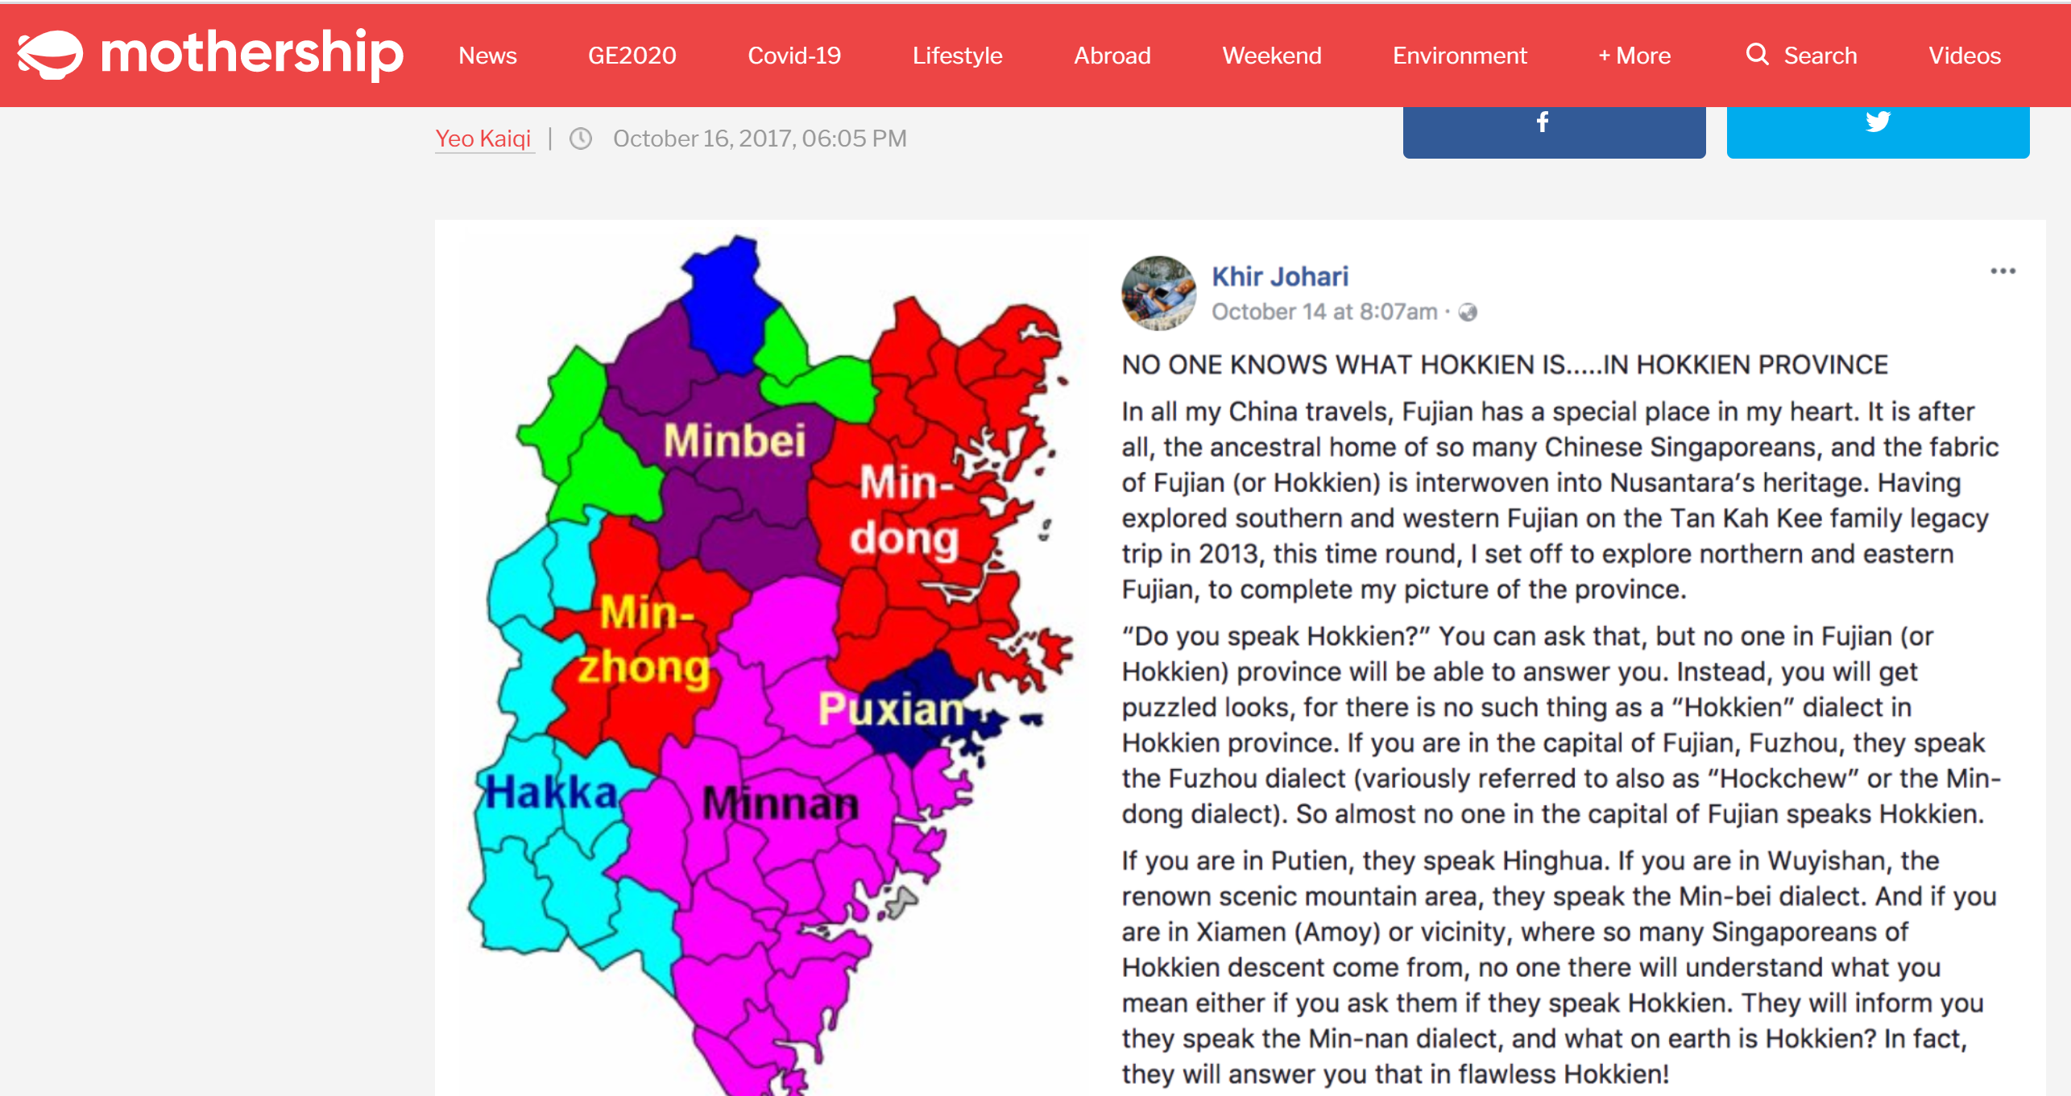

Slide 41
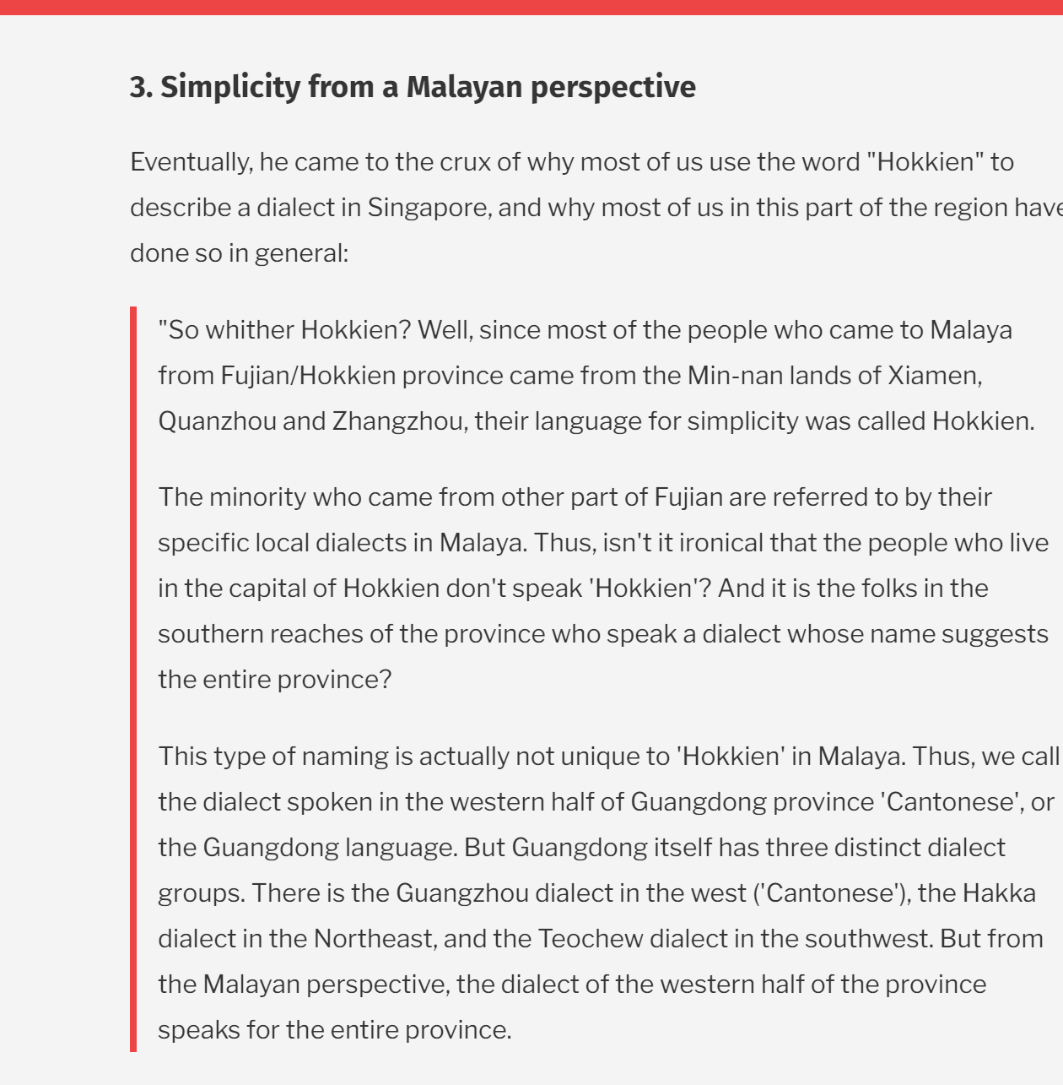

Slide 42
Linguistically, the Hokkien and the Teochew dialects are Southern Min dialects.

Slide 43
The issue of Teochew dialect group
Notes:
Teochew say the same southern min dialects – but live in a different administrative region Guangzhou province

Slide 44
Southern Min dialects
Henghua dialect / Putian dialect
Northeastern Min dialects
Notes:
Hokkien Teochew chock chia Hainanese ha

Slide 45
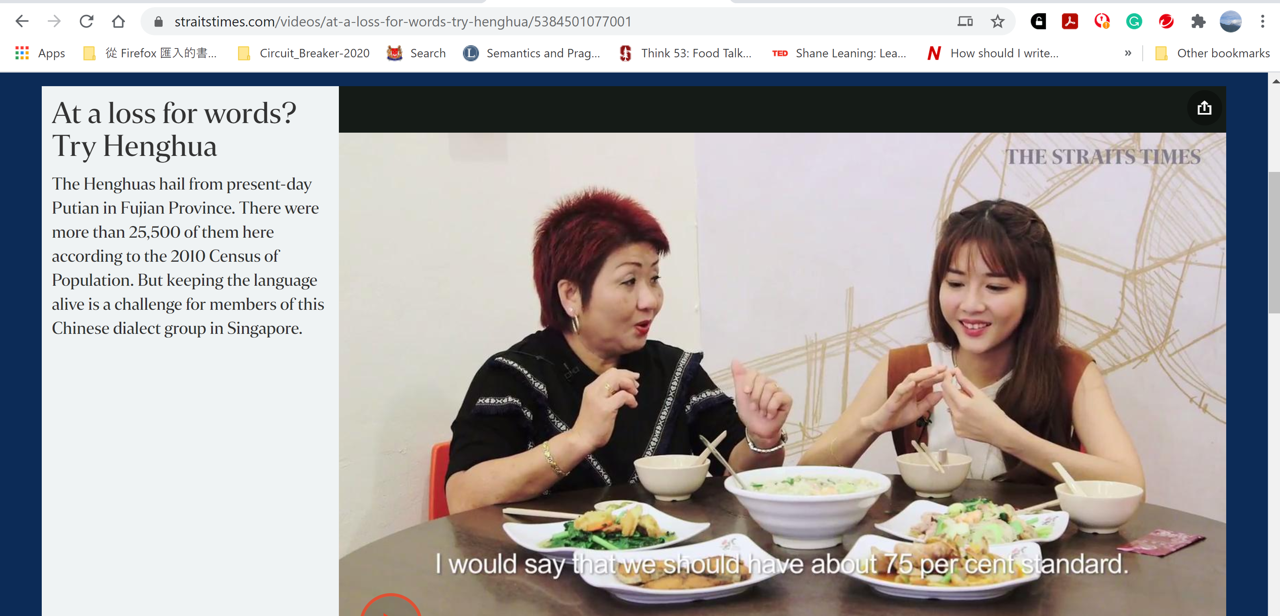

Slide 46
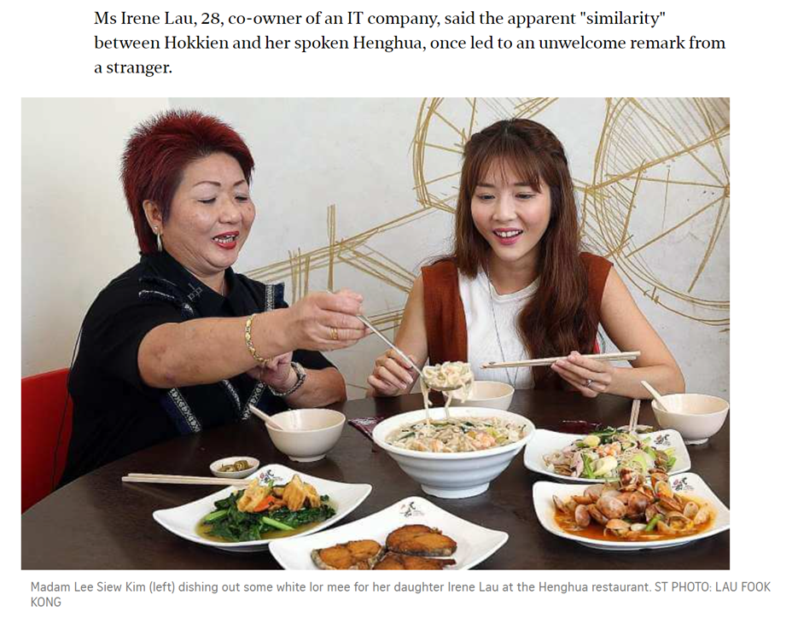

Slide 47
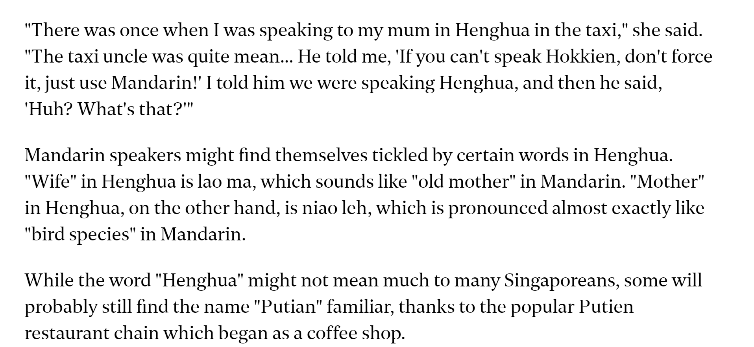

Slide 48
Southern Min dialects
Henghua dialect / Putian dialect
Hainanese dialect
Northeastern Min dialects
Notes:
6 dialect groups (Hokkien, Teochew, hOCK chew Hoch chia, Hainanese, Heng Hua)
But dynamics all different
Non min – hakka canton madrin shanghai

Slide 49
Dialect profiling / stereotyping

Slide 50


Slide 51

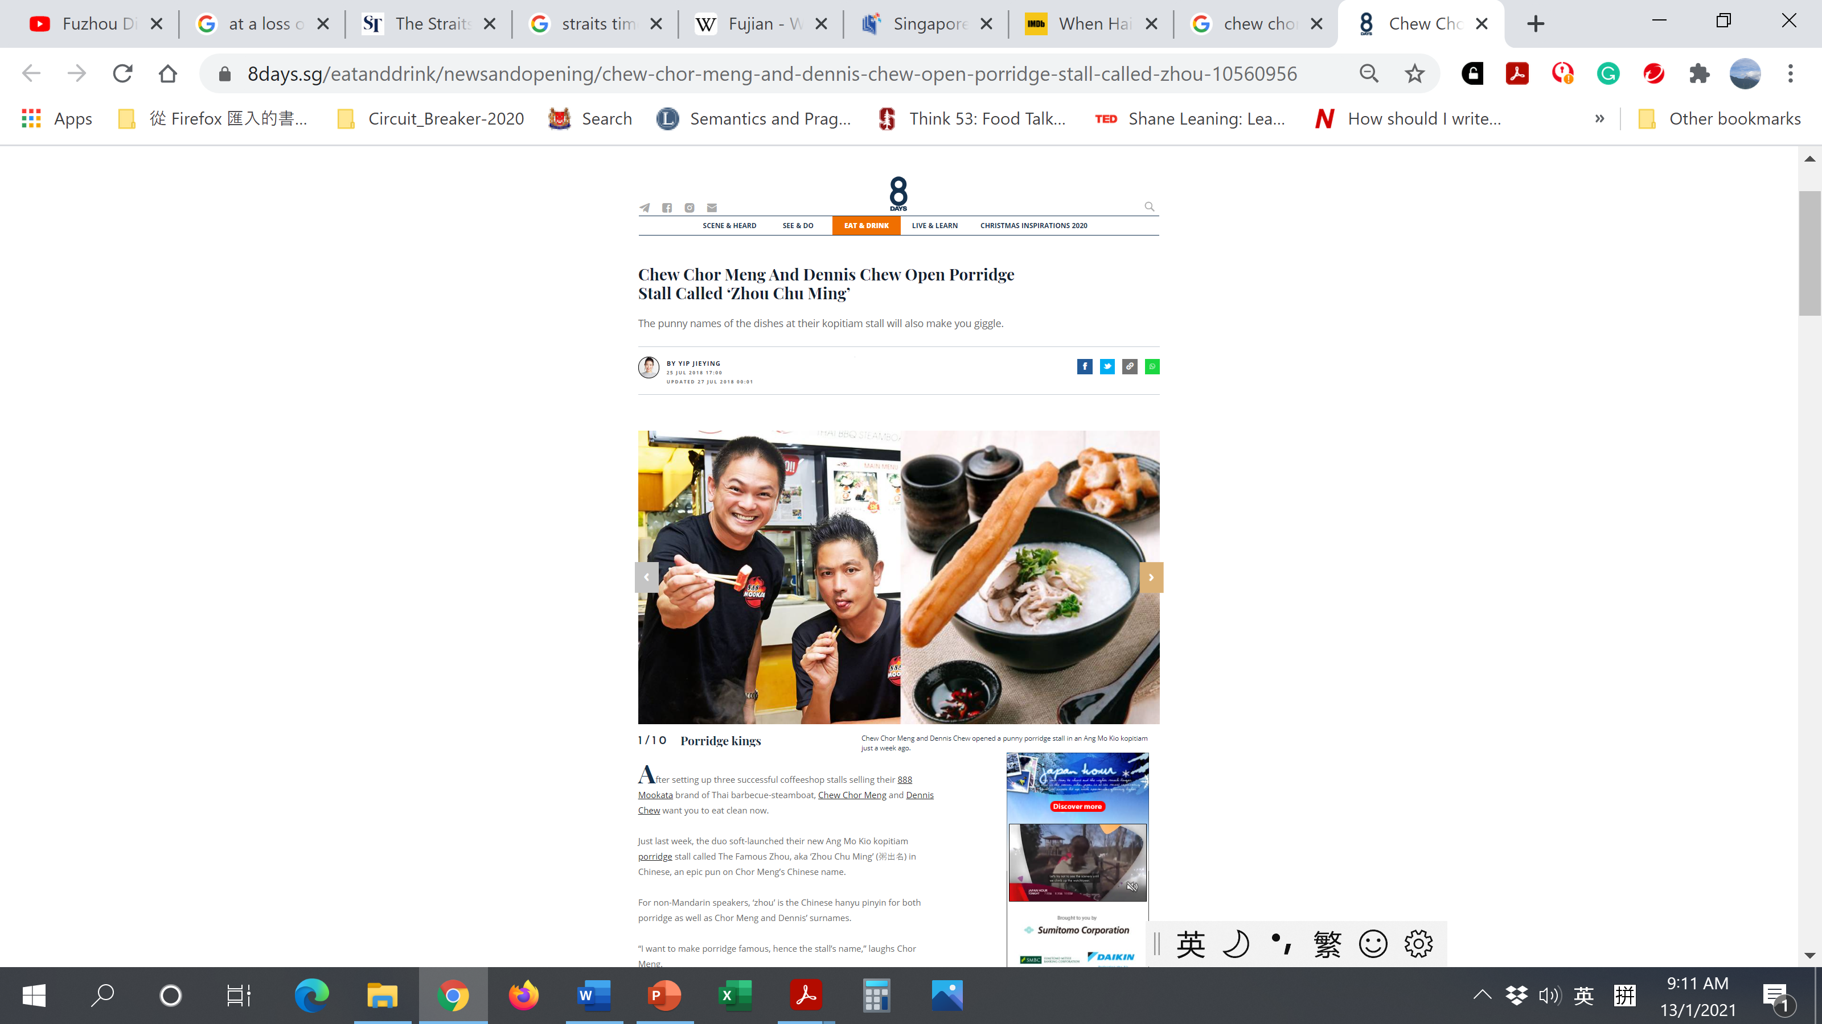

Slide 52

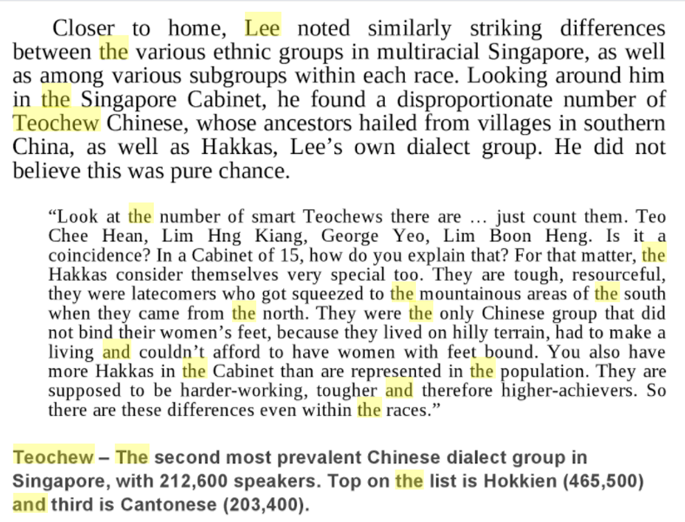
pp. 171–173

Slide 53
The Cantonese dialect group in Singapore

Slide 54


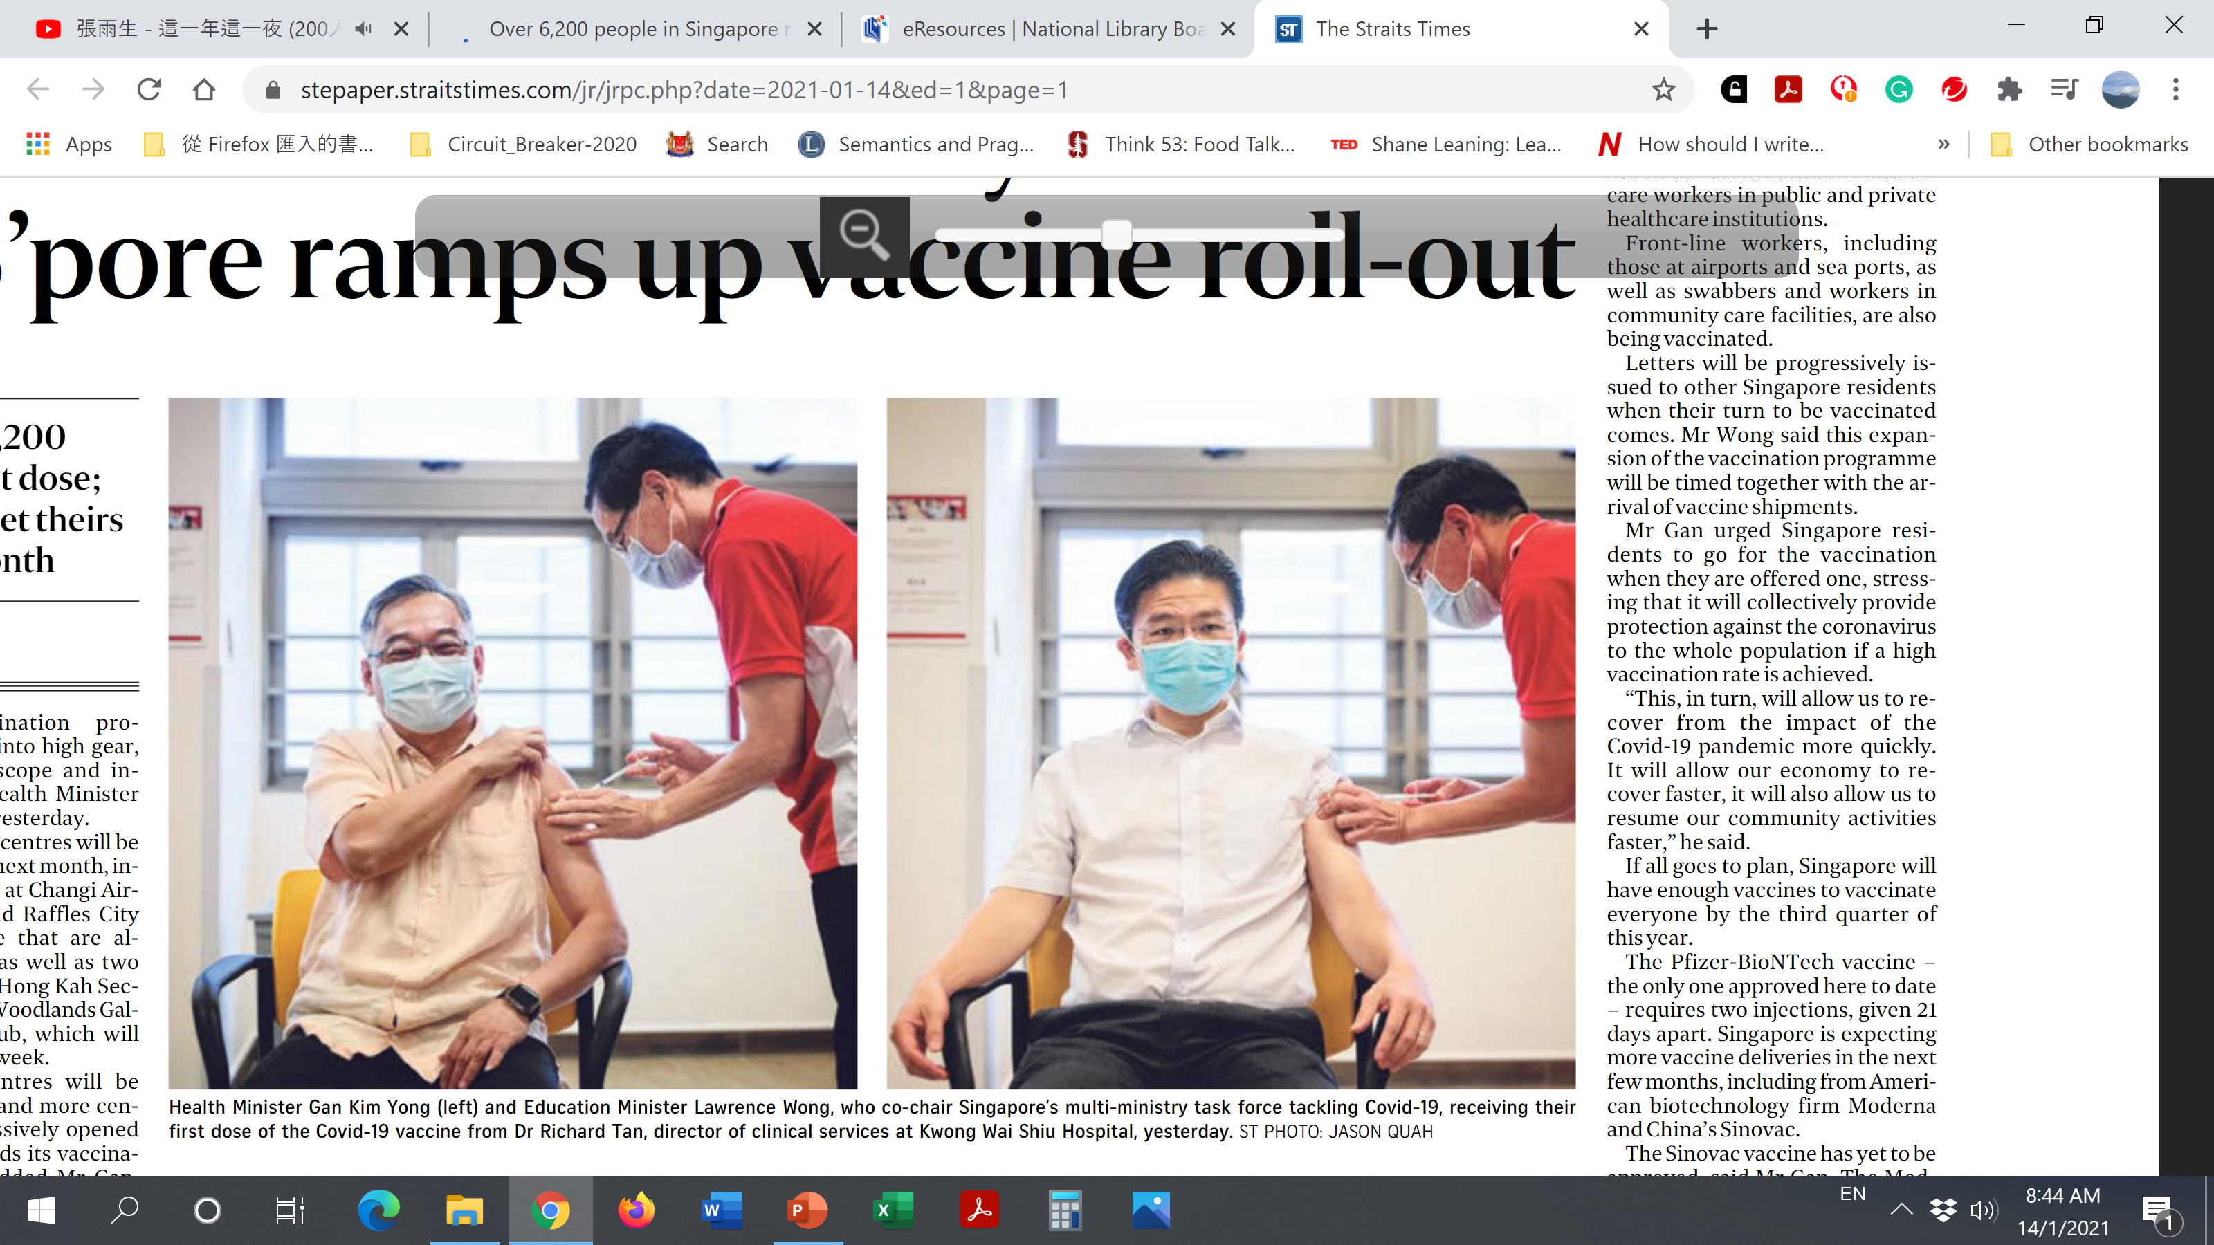
Notes:
Tells us something about the Cantonese dialect in singapore

Slide 55
Map of Guangdong province
Notes:
There exists hakka in Guangzhou province also (huizhou) – hakka and Cantonese (zhaoqing) have a good relation

Slide 56
The Hakka dialect group in Singapore
Orgins of Fujian and GuangDong province
Notes:
Check aw boon haw, aw boon par – prominent hakka leaders (from Fujian hakka)
Their relationship with the hokkien huay guan is of interest
Does the hokkien huay guan serve hokkiens only, or for the everyone from the province

Slide 57
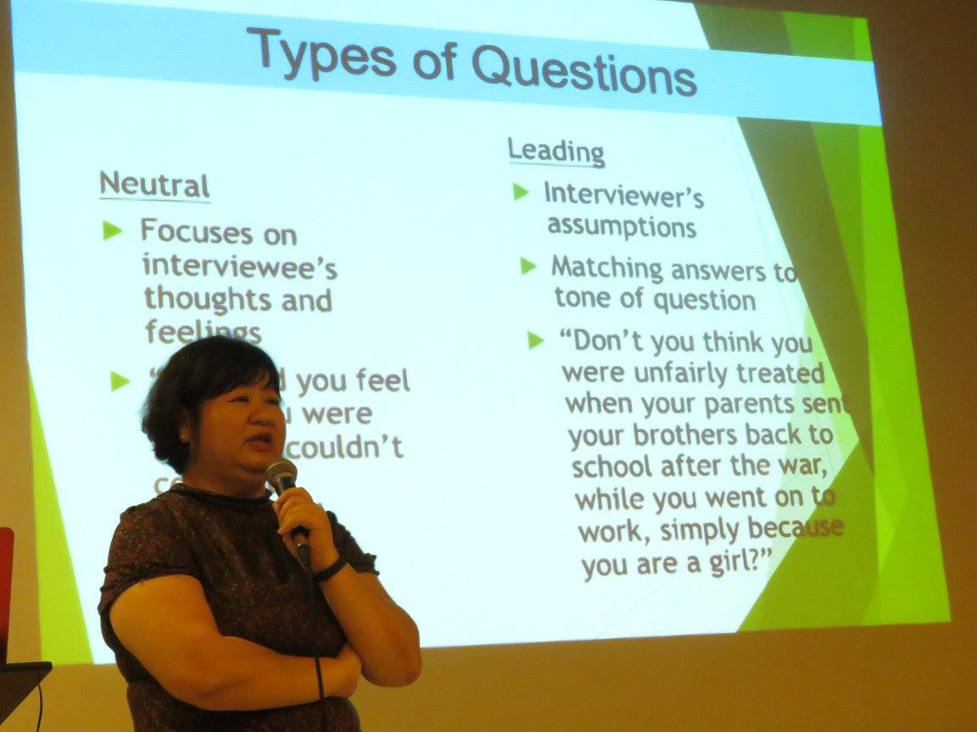
Guest lecture on Hakka in week 6
Adjunct Assistant Professor Lye Soo Choon

Slide 58
The Mandarin dialect and Putonghua

Slide 59
Geographical distribution of Modern Chinese dialects in China

Slide 60
Mandarin dialect

